Slide 1
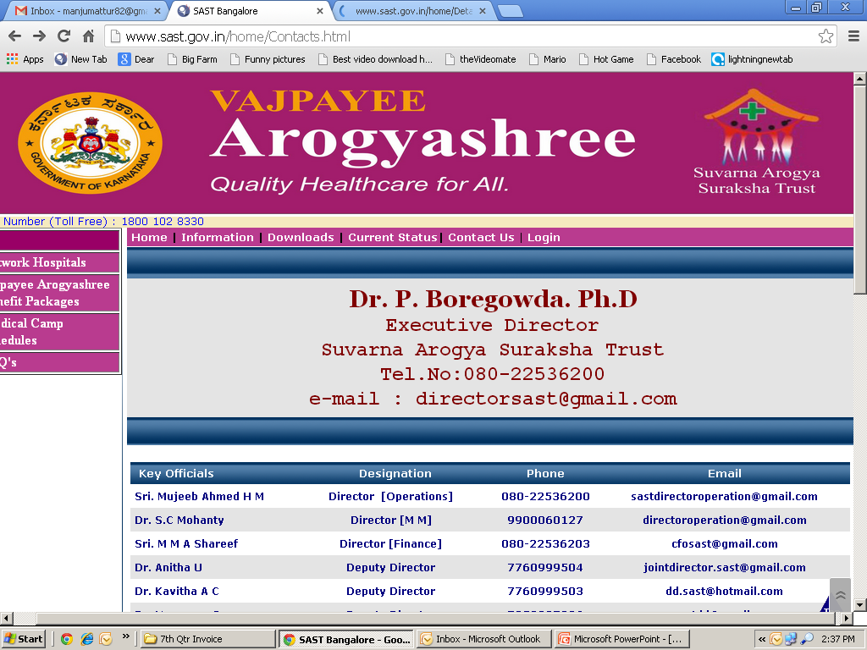
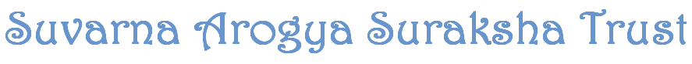
Government of Karnataka
Department of Health & Family Welfare
Making it happen: Universal Health coverage for tertiary care in Karnataka, India
KACHCON 2015
31st October 2015
Dr. P Boregowda, Dr. Sudhashree Chandrashekar,
Dr. Vishwaradhaya, Suresh Wesley

Slide 2
To achieve the objectives of Universal health coverage in Karnataka for tertiary care
Suvarna Arogya Suraksha Trust was created
IMPLEMENTATION
Special Purpose Vehicle established under Trust Act
The Chief Minister - Chief Patron
The Minister for Health & Family Welfare & The Minister for Medical Education – are member patrons
SAST Governing Bodies
Board of Trustees.
Executive Committee
Empanelment & Disciplinary Committee

Slide 3
Schemes implemented by SAST to achieve universal health coverage in tertiary sector
SAST Schemes
VAS
RAB
JSS
RBSK
RAB
For BPL
For APL
For State Govt. Employees
For Govt/aided School Children
BPL-Below Poverty line population
APL-Above Poverty line population

Slide 4
Why Health assurance?
Majority of the Government Hospitals are not equipped to treat beneficiaries with Tertiary ailments.
In 2009-10, VAS was introduced by GoK wherein all BPL card holders were automatically enrolled to be eligible for free tertiary treatment in network of super specialty hospitals through PPP mode.
The main objective of the scheme was to reduce Out Of Pocket (OOP) expenditure among BPL families and to have access to quality Tertiary Healthcare .

Slide 5
Vajpayee Arogyashree Scheme
For BPL Families

Slide 6
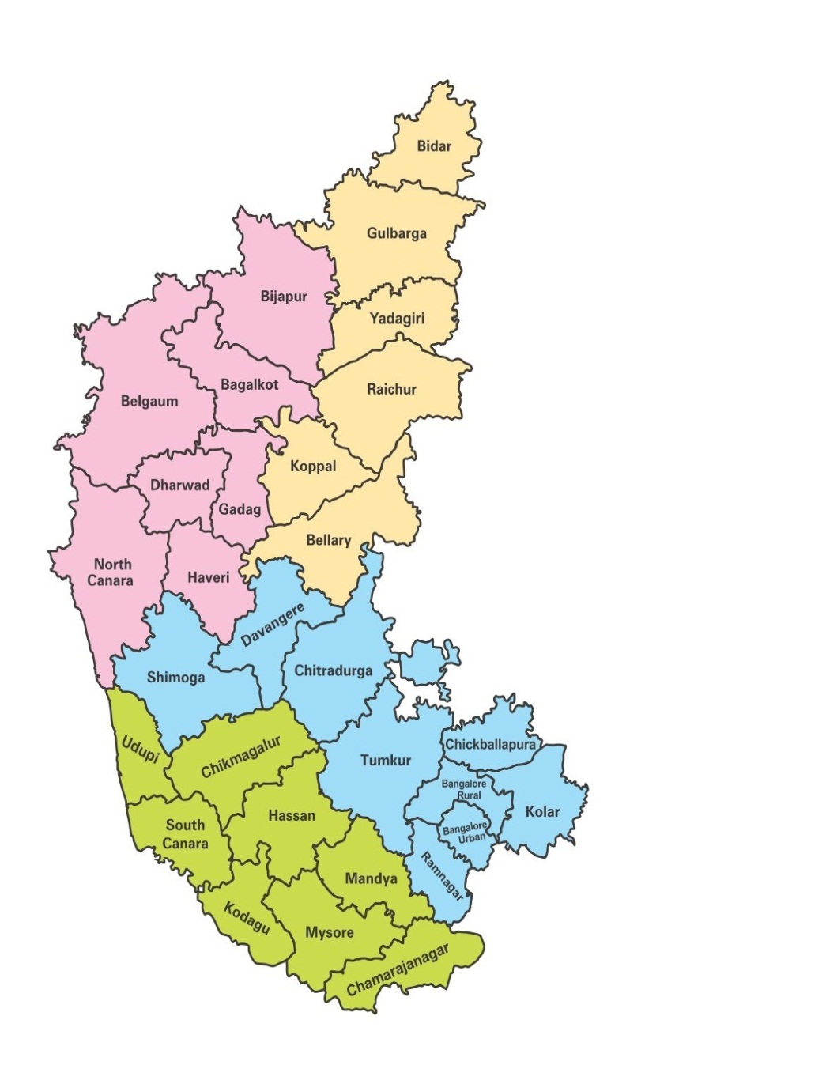
VAS was Implemented in a phased manner
To understand the implementation hurdles & to gain experience, VAS was initially piloted in the backward divisions of Gulbarga & Belgaum in 2010 & was scaled up throughout the State from June 2012 onwards.
Belgaum Division
Gulbarga Division
Aug 2010
Feb 2010
Bangalore Division
Mysore Division
June 2012
June 2012

Slide 7
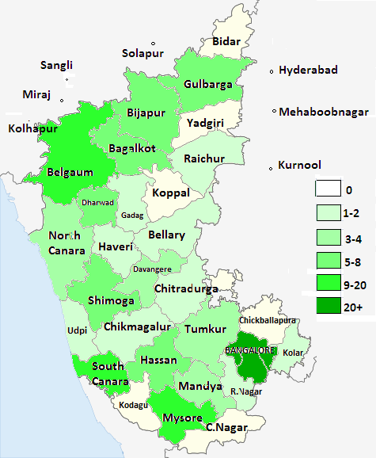
Empaneled Hospitals- Density
Total :194 Hospitals
Government : 25 Hospitals
Private : 119 Hospitals
Outside State : 40 Hospitals

Slide 8
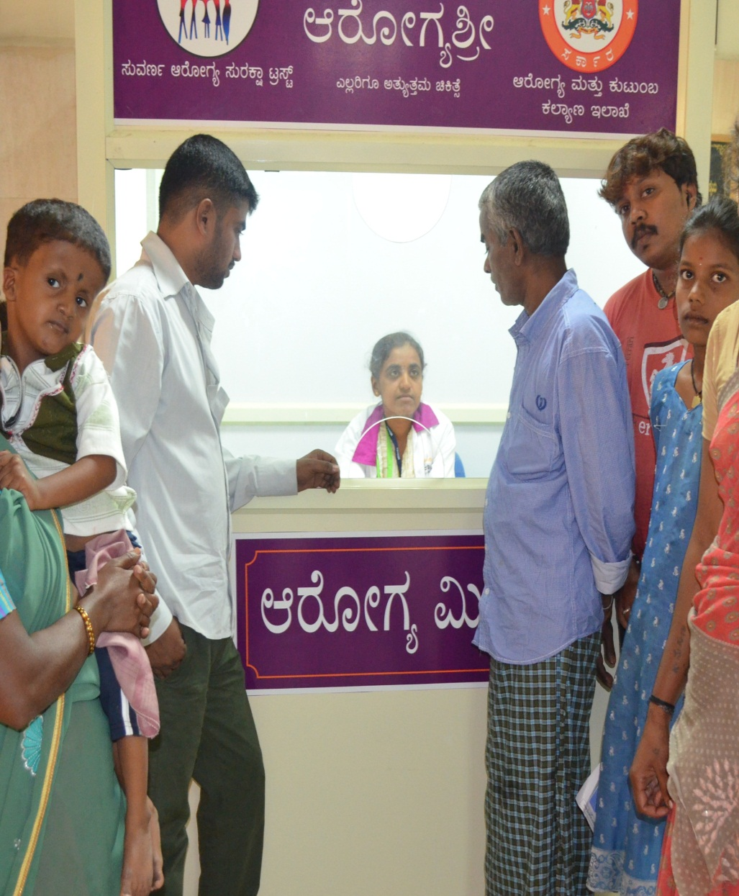
VAS BENEFITS
Assurance to VAS Beneficiaries: Rs 1,50,000/- on family floater basis + Rs.50,000/- as buffer on case to case basis
Benefit Package list and rates are fixed: 449 procedures covered along with 60 Follow-up Packages
The transaction is truly cashless
Arogyamitra kiosk in every Network hospital to provide information to beneficiaries

Slide 9
KIOSK / Information Centre
KIOSKS functional in all 30 Districts,146 Taluk hospitals and in all NwH to facilitate beneficiaries.

Slide 10
Specialties included
Benefit Packages
Cardiology
Neurosurgery
Urology
Neonatal & Pediatric Surgeries
Polytrauma
Burns
Oncology
Benefit Package : 449 procedures & 60 follow-up packages under 7 Broad Specialties

Slide 11
Components of Packages
Consultation, diagnostics, medicines, specialist services
Medical devices, Procedure, Complications
Hospital charges, Follow-up
Food
Cost of transportation
Comprehensive Pricing Perspective

Slide 12
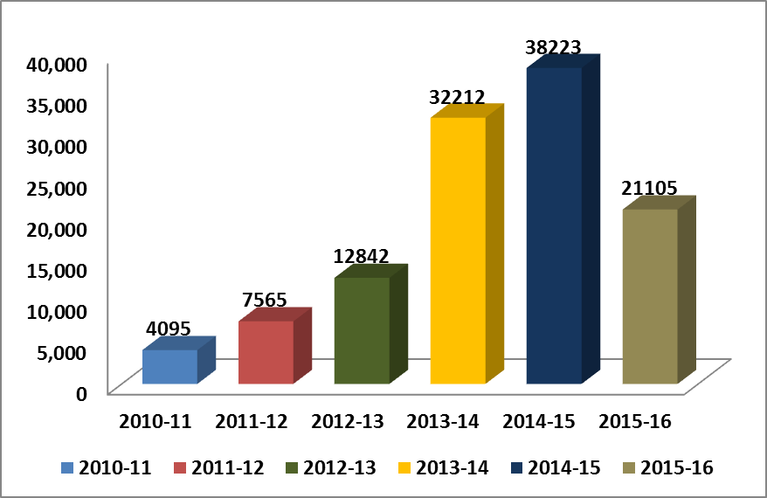
Utilization of VAS
The number of beneficiaries has increased by more than nine fold over the years.
Cumulatively, the total number of beneficiaries is 1,07,999 & the total expenditure is Rs. 616.82 crores.
Cardiology & Cancer together account for 75 % of the total cases treated with Cardiology – 44 % & Cancer – 31 %.

Slide 13
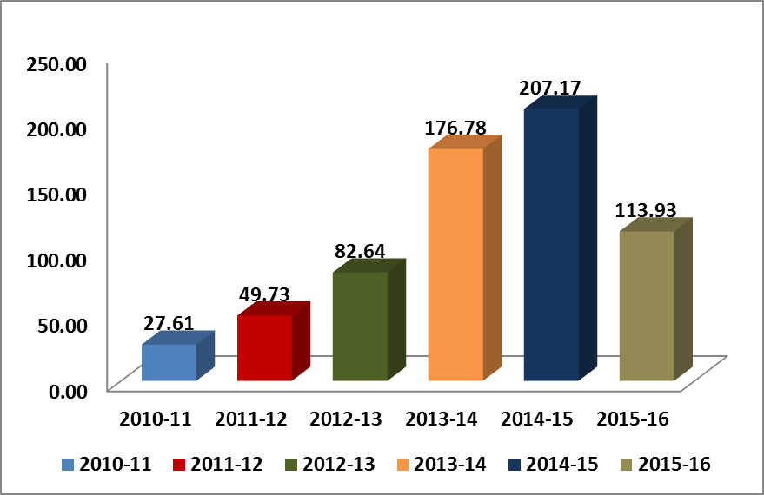
VAS scheme expenditure over the years
Of the budget allocated amount of Rs. 140.01/- crores for 2015-16, 81% of the allocation has already been spent in the months of April to September 2015.

Slide 14
Specialty & Age wise Distribution
The above chart depicts Age Wise quantum of beneficiaries treated
The maximum number of cases treated falls in the most productive age
group of 26 years to 60 years constituting about 64 % of the total cases
treated.
The major contributors across all age groups are Cardiology and Cancer

Slide 15
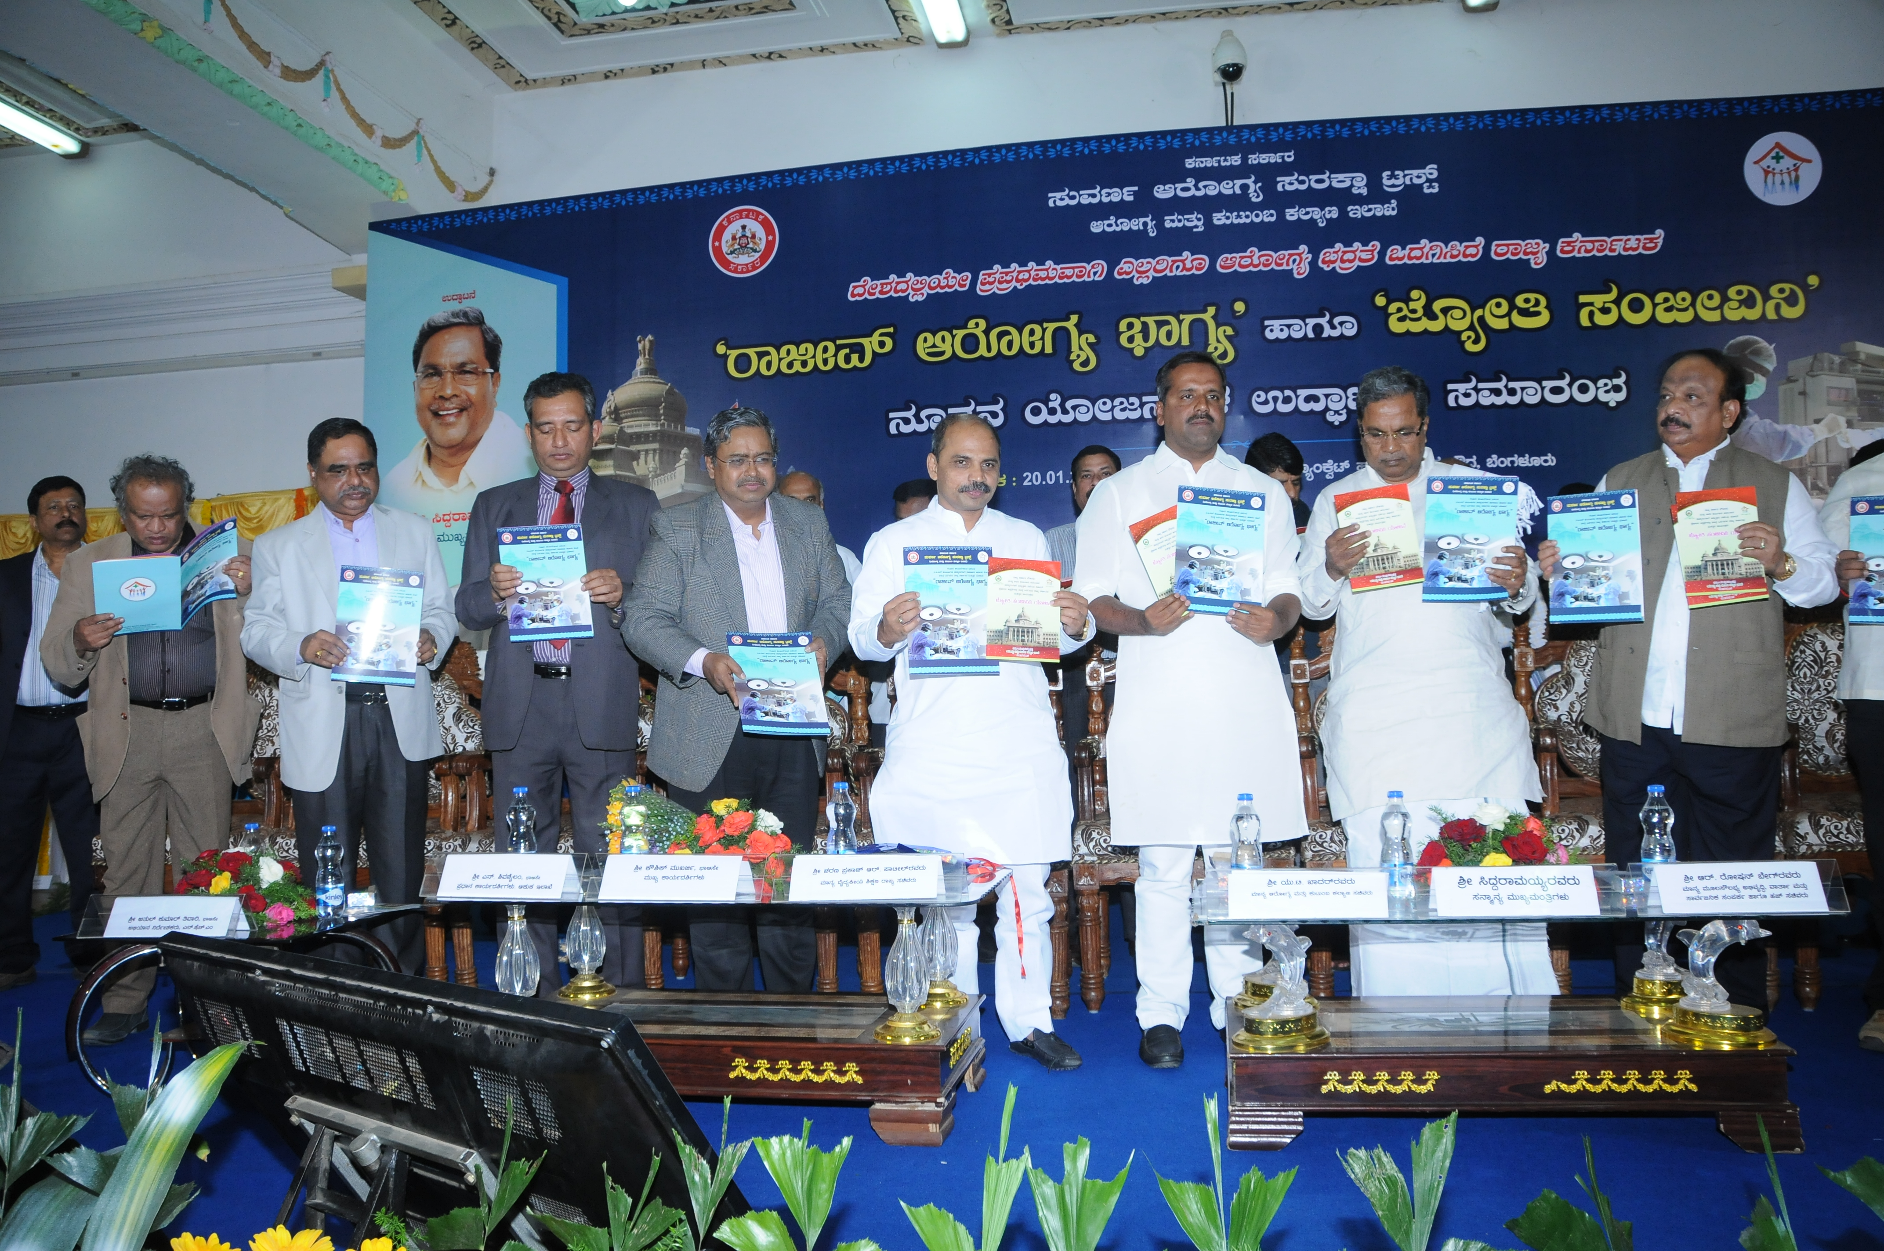
Two new Schemes launched January 2015

Slide 16
Rajiv Arogya Bhagyascheme
For APL Families

Slide 17
Objective
Financial protection for the Non-BPL Population against catastrophic spending on Tertiary Healthcare service
Making Tertiary Health care accessible and affordable for non- BPL population
To better the Morbidity and Mortality status of the Non-BPL population

Slide 18
Salient differences from VAS
For NON-BPL population-APL card
Semiprivate and Private ward rates are declared by Hospitals.
No Camps
SAST intends to publish the declared rates of the semi-special and special wards of all the empanelled hospitals.
Copayment by beneficiaries-30% for General ward and 50% PLUS for other wards
Contents of the Package(Inclusions and exclusions)

Slide 19
The package rates includes
Registration charges,
Ward Charges for the duration of the stay,
Surgery/procedure charges,
Investigation charges (if it is part of the treatment),
Postoperative Ward/ICU/ventilator Charges,
Consumables used while treatment like stents, implants, valves, prosthesis, grafts etc., and
Medicines required in the period of Hospital stay.

Slide 20
The Package rates does not include
Preoperative investigation charges,
Diet charges,
Transportation charges,
Post discharge medicine charges,
follow-up charges,
non- medical charges and
ambulance charges in case of death

Slide 21
Mobile APP for RAB scheme
Mobile APP for RAB scheme
Mobile APP for RAB scheme was launched, to assist the beneficiaries to choose the hospital due to the varied rates - Choose, compare and decide your choice of hospital to receive tertiary care. The Mobile App would facilitate the beneficiary by providing following required information -
  Hospitals located within the distance of his/her choice.
  It will also display hospitals which are empanelled to treat the particular procedure with the rates for Semi Private and Private wards.

Slide 22
Jyothi Sanjeevini
Scheme
For Govt. Employees and their dependents

Slide 23
Beneficiaries
All State Government Employees and their dependent family members are covered Identified by Karnataka Government Identity number uploaded in the human resource management database.
The Govt Servants and their dependents shall not be eligible ,If the benefits are already availed in any of the other Govt. Sponsored health schemes like Arogyabhagya of Police department, etc

Slide 24
Differences from VAS
No financial cap per family
Best of the Central Government Health Scheme and VAS rates are considered while fixing the General ward rates
Provision for treatment in Semiprivate and Private Ward which is based on range of Pay.
Supplementary packages for Consumables like stents/implants etc .

Slide 25
The package rates includes
Components of Packages
Consultation, Diagnostics, Medicines,
Procedure, Complications, Hospital charges, Follow-up,.
Food
Ambulance charges in case of death

Slide 26
Entitlement of Wards pertaining to the Pay Scales :
Sl. No. | Range of Pay | Category of Wards/Class of Accommodations to which entitled | Rates
1 | Upto Rs. 16,000/- per month | General Ward | As per rate list of Annexure III of MOU
2 | Rs. 16,001/- to Rs. 43,200/- per month | Semi Private Ward | 10% higher than general ward rates
3 | Rs. 43,201/- & above | Private Ward | 25% higher than general ward rates
If the beneficiary desires to go for higher ward than entitled for , the difference amount shall be borne by the beneficiary and the hospital has to obtain a written consent .

Slide 27
RASHTRIYA BALA SWASTHYA KARYAKRAM (RBSK) SCHEME
Beneficiaries - The Rashtriya Bala Swasthya Karyakram (RBSK) Scheme is for -
  Children of 0-6 yrs. from Rural & Urban slums
  6-18 yrs. Children studying in 1-12th Std Govt. & Govt. Aided Schools
Specialties covered – 4 specialties that is Cardiac, Cardio thoracic, pediatric surgeries, oncology & Neurosurgery, are covered.
Treatment provided – include 102 procedures under SAST specialties
Financial limit – – is Rupees 1.5 lakh per family in each fiscal year; CASHLESS type. In special conditions, additional amount of Rupees 50000, can be sanctioned.
Number of network hospitals – 45 hospitals are empanelled under SAST for providing RBSK scheme in Karnataka including 1 hospital outside the state.

Slide 28
      To provide Health Security to the people of Karnataka, SAST, an autonomous body was established to implement Tertiary care schemes on a project mode.
      About 93% of Total Karnataka population is being covered by SAST, balance 7% covered under other Government & Private Insurance.Thus Karnataka Is the first state in the country to move towards UHC in Tertiary Sector.
Scheme Name | Year | Target population | Population Coverage in %
Vajpayee Arogya Shree (VAS) | 2009-10 | All BPL families in Karnataka | 69%
Rajiv Arogya Bhagya (RAB) | 2014-15 | All APL families in Karnataka | 19%
Jyothi Sanjeevini (JSS) | 2014-15 | All State Government Employees and their dependents . | 5%
Mukhya Manthrigala Santhwana Scheme(MSS) | 2014-15 | Accident Victims on the roads in the territory of Karnataka | 100%

Slide 29
How we did it?
Effective Care: delivering health care that is adherent to an evidence base and results in improved health outcomes
Efficient care: delivering health care in a manner which maximizes resource use and avoids waste;
Accessible Care: delivering health care that is timely, geographically reasonable,;
Equitable Care: delivering health care which does not vary in quality because of personal characteristics such as gender, race, ethnicity, geographical loca- tion, or socioeconomic status;
Acceptable Care: patient-centred,
Safe care: delivering health care which minimizes risks and harm to service users.

Slide 30
Initiative for effective care
Well defined treatment procedures: covers priority high burden diseases - 7 tertiary specialties, 449 procedures
Standard treatment guidelines: for oncology, Neurology and cardiology
Follow-up protocols are developed for Cardiology and Neurology upto one year post treatment. De-centralisation of follow-up to district hospitals
Arogyamitra: The ambassadors of health placed in all Taluk CHCs and Network Hospitals to guide and facilitate the identified patients in getting appropriate care at the appropriate time and place.

Slide 31
Initiatives for efficient care
Benefit package rate: fixed In consultation with independent specialists Costing study of 12 hospitals and 25 procedures is underway to assess the appropriateness of pricing.
Gate Keeping: Implementation Support Agency (ISA ) and trust , a strong two tiered control mechanism is in place for approval of both preauths and claims to control misuse, misappropriation and unwarranted surgeries.
Dynamic IT platform: On line platform functional right from Hospital Empanelment to Scheduling of Health Camps to Preauth Approvals to Claims Settlement and sending important alerts to beneficiaries.
E Medical Health Records-All details of the patients and investigationr reports, treatment history is available in the online database which facilitates analysis.
Timeliness: Preauths are approved within 24 hours & claims are settled within 7 days through RTGS.
92 % of the preauths now being approved within 24 hours. Of these, 54 % are approved within 6 hours & 9 % within 7-12 hours.

Slide 32
Initiatives for Acceptable care
World Bank Impact Study-Published in BMJ
Key Results
Reduction in OOP expenditure by 64 %.
Reduction in Mortality rate by 68 % among BPL families compared to VAS non-eligible households.
“Insuring poor households for efficacious but costly & underused health services significantly improves population health in India”
(Sood N et.al, BMJ 2014;349, Published 11 September 2014)
Appropriate Use Criteria (AUC) & Cardiac Care study
Study assessed 600 patients from 28 hospitals in Karnataka for 300 CABG and 300 Stent procedures.
In our study 90 % of the sampled cases were appropriate, only 10 % of the cases fell under the category of inappropriate or uncertain category

Slide 33
Making quality care available to beneficiaries
Incentivizing hospitals to move towards NABH accreditation. 2% of total claims amount for full accreditation and now planned 2% of entry level, 5% for progressive and 10% for fully accreditated hospitals.
NABH entry level accreditation mandatory for empanelment of new hospitals under the SAST scheme
Already empanelled hospitals have been given two years to achieve entry level accreditation for continuation of empanelment
NABH sensitization workshop has been organised for full accreditation land entry level this year. More than 60 hospitals participated and 20 hospitals have applied for entry level accreditation
Hospital infection control practices assessment underway

Slide 34
Adequate monitoring of safe delivery of services through empanelled hospitals
An independent agency has been contracted to assess the processes and implementation of SAST schemes
Patient satisfaction feedback and beneficiary hospital visit and home visits undertaken and corrective measures taken
Mobile application to display rates/distance of available NWH to give more informed choice to the patients to choose the hospital
Surprise visits to hospitals to monitor the service delivery
Call centre 24/7 to receive grievances, provide information and follow-up well being of beneficiaries and take feedback is functional.
Grievance co-ordinator to address issues at the state level
Mortality audit cell set up: The main aim is to evaluate trends in causes of mortality over time and address specific issues to reduce hospital related deaths and improve quality of patient care.

Slide 35
Challenges encountered and how they were resolved
Patients being charged for investigations
Empanelment discipline committee addressing these deviations by network hospitals and enforced the decision to impose penalties for the deviations, which is as follows;
For the first time deviation double the amount collected, second deviation 3 times the amount collected, and for third time deviation 4 times the amount collected.
If this is continued dis-empanelment of Hospital.
Patients paying for transport
Empanelment across the border was permitted to address access and transport problems

Slide 36
Challenges encountered and how they were resolved
Sudden reduction in empanelled hospitals from 134 to 73 hospitals with 61 hospitals not continuing their empanelment due to delay in payment for claims submitted
Strengthening IT system to make online transactions for both approvals and clearing claims through RTGS within 7 days which helped in bringing back the hospitals who had moved out and now 194 hospitals are under SAST network
Lack of skilled manpower especially super specialists
Allowing flexibility of schedules for specialists in less developed districts of the North, by allowing visiting privileges in more than one hospital and empaneling all.
Incentivizing government doctors and Involving govt. medical colleges with certain specialties to be a part of the scheme

Slide 37
Challenges encountered
Hospitals were only performing high cost procedure
Revision of pricing through a consultative process with involvement of both private and public sector specialists by forming consultative committee for each speciality

Slide 38
Lessons Learned- 1
Government stewardship crucial
It is indispensable for steering the process during implementation and for sustainability
Strong administrative leadership to operationalize and scale up the scheme
Clear governance structure with key policy makers sharing responsibility and quick decision making

Slide 39
Lessons Learned 2
Maintaining the true spirit of Public Private Partnership
Leveraging the available strong pool of public and private providers in the state
Clear, defined Empanelment criteria and binding MOU and ensuring adherance to it in letter and spirit
Flexibility within a defined framework- For eg: Relaxation of Pre-authorisation approval for Emergency cardiac and other procedures.
Comprehensiveness of the Packages and Competitive Consultative Pricing
Complete online transactions reducing TAT and ensuring timeliness of care to beneficiaries has been a driving force to retain the hospitals participation in the scheme

Slide 40
Lessons Learned 3
Ensure Financial Sustainability of Schemes
State health Budget funds Vajpayee Arogya Shree Scheme(VAS) for Below Poverty line beneficiaries
Shortfall for VAS resources raised through World Bank’s –Pay for results initiative and Phased approach for geographic expansion across the state
Co-financing from other department funds
For eg: Jyothi Sanjeevini Scheme funded by Department of Personnel and Administrative reforms
Central government partnership to share financing for Rashtriya Bala Swasthya Karyakram
Co-payment by beneficiaries for Rajiv Arogya Bhagya Scheme for Above Poverty line beneficiaries

Slide 41
Summary
Thus with all these initiatives SAST is leading an example for ensuring quality care for government sponsored health schemes in the country.
This has proven that the SAST model of purchasing healthcare services from the private sector for providing tertiary care is scalable and replicable by other States/developing Countries.
The Government of India has recognized the organization structure of SAST and has been recommending all the states to follow the SAST model for implementation of Rashtriya Swasthya Bima Yojana.
This is truly a significant recognition of the successful implementation of the schemes by Suvarna Arogya Suraksha trust.
For more information visit www.sast.gov.in/home

Slide 42
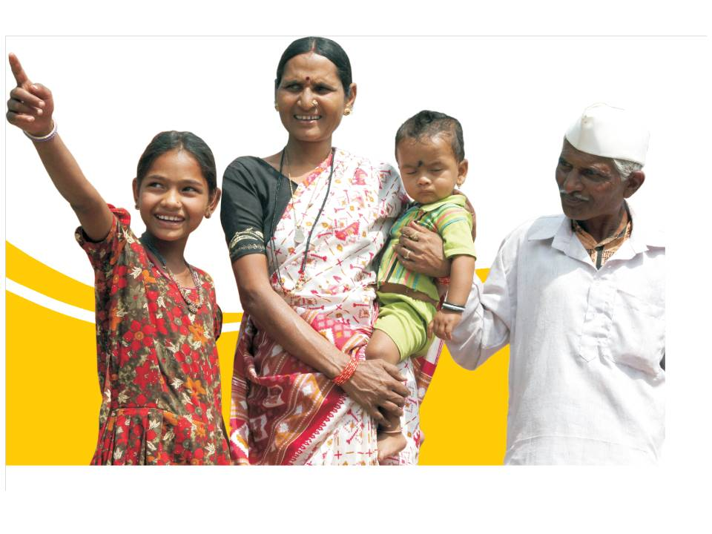

Thank You

